Slide 1
DJANGO generic Editing view
江琳

Slide 2
Philosophy
The edting views are used to provide a foundation for editing content.
django.views.generic.edit.CreateView
django.views.generic.edit.UpdateView
django.views.generic.edit.DeleteView

Slide 3
Review -- Listview

Slide 4
Library system
Part one: Library System
Homepage
Book list page
Book detail page
Part two: Library Management System
Login page
Create book, author, publisher, category
Book list
Update book

Slide 5

Review -- listview
Let’s using ListView to create the book list page.
class BsList(ListView): ''' backstage book list page ''' template_name = 'backstage/bs_list.html' model = Book

Slide 6
url.py
Add url for book list page
url(r'^backstage/books/$', BsList.as_view(), name='bs_list'),

Slide 7

Bs_list.html
<body> <div class="head">Library Management System</div> <div> <div style="padding: 10px 0"> <a href="" class="btn">New Book</a> <a href="" class="btn">New Author</a> <a href="" class="btn">New Publisher</a> <a href="" class="btn">New Category</a> </div>

Slide 8
<table style="width: 100%"> <tr style="background-color: #c4dce8"> <th>Name</th> <th>Author</th> <th>Publisher</th> <th>Release</th> <th>Serial NO.</th> <th>Category</th> </tr> {% for book in object_list %} <tr> <td>{{ book.name }}</td> <td>{{ book.author.name }}</td> <td>{{ book.publisher.name }}</td> <td>{{ book.pub_year }}</td> <td>{{ book.serial_num }}</td> <td>{{ book.category.name }}</td> </tr> {% endfor %} </table> </div> </body>

Slide 9
<head> <meta charset="UTF-8"> <title>Library Management System</title> <style> .head{ padding: 20px 0; color: #ffffff; font-size: 20px; font-weight: bold; text-align: center; background-color: #79aec8; } .btn{ background-color: cadetblue; color: #ffffff; padding: 5px; } .btn:link{ text-decoration: none; } </style> </head>

Slide 10
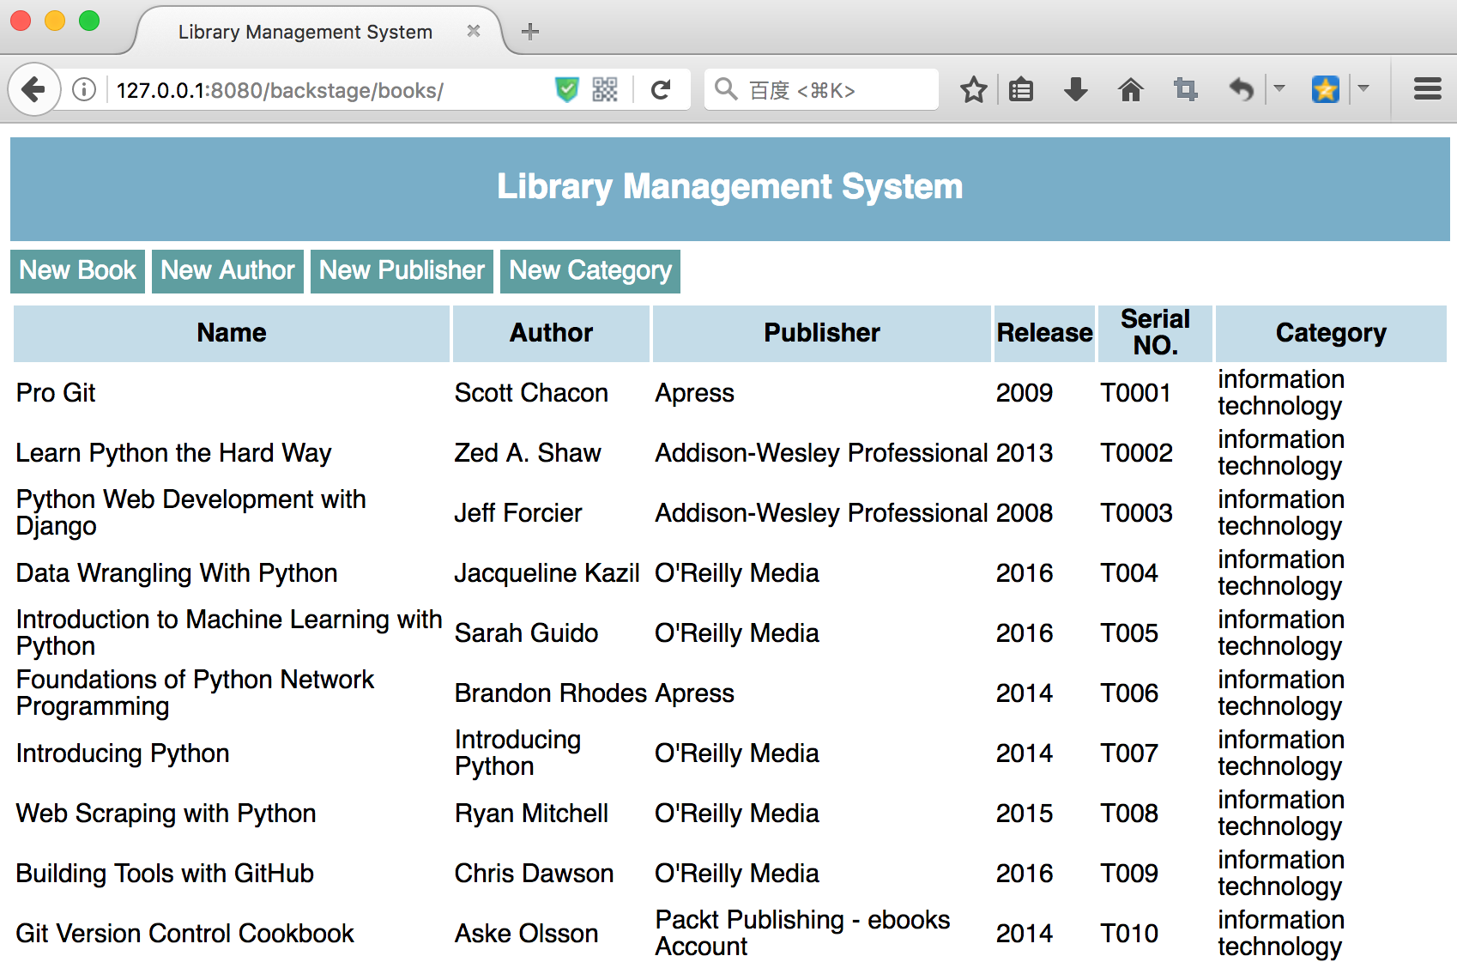

Slide 11
Createview

Slide 12
createview
A view that displays a form for creating an object, redisplaying the form with validation errors (if there are any) and saving the object.
django.views.generic.edit.CreateView

Slide 13
Library system
Part one: Library System
Homepage
Book list page
Book detail page
Part two: Library Management System
Login page
Create book, author, publisher, category
Book list
Update book

Slide 14

createview
Let’s write a page used to create author using CreateView
class CreateAuthor(CreateView): model = Author template_name = 'backstage/create_author.html' fields = ['name', 'intro']
def get_success_url(self): messages.success(self.request, ‘Create Success!’) return resolve_url('create_author')

Slide 15
url.py
url(r'^create/author/', CreateAuthor.as_view(), name='create_author')

Slide 16
Create_author.html
<body> {% for msg in messages %} <div class="{{ msg.tags }}">{{ msg }}</div> {% endfor %} <form method="post"> {% csrf_token %} {{ form.as_p }} <input type="submit" value="Submit"> </form> </body>

Slide 17
Create_author.html
<head> <meta charset="UTF-8"> <title>Author Create</title> <style> body{ padding: 10px 100px; background-color: #c4dce8; } .success{ background-color: #79aec8; padding: 10px; color: #ffffff; } </style> </head>

Slide 18
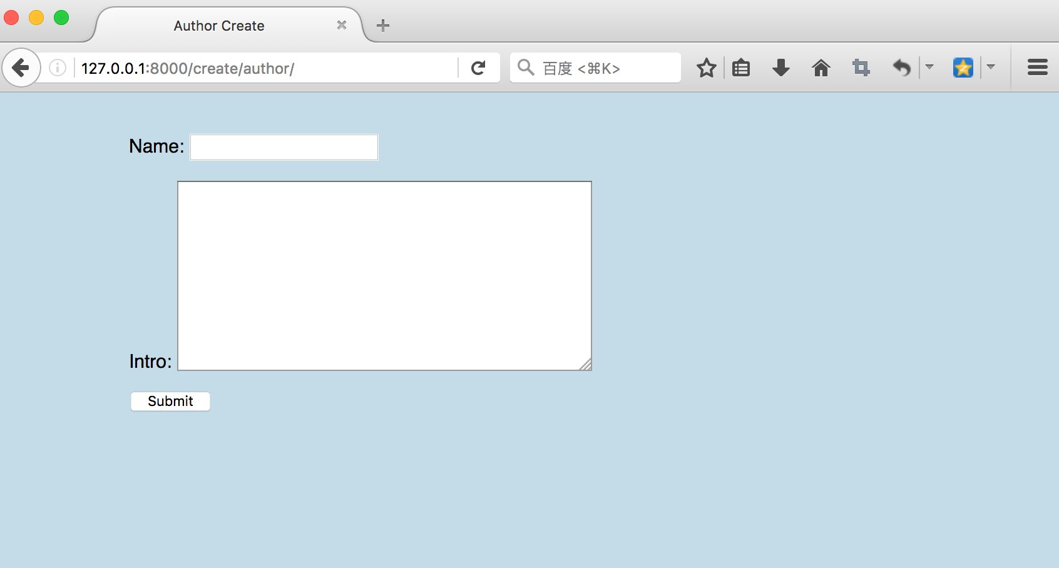
createview

Slide 19
{{ from.as_p }}
{{ form }} will render <label> and <input> elements appropriately.
{{ form.as_p }} will render them wrapped in <p> tags
{{ form.as_ul }} will render them wrapped in <li> tags

Slide 20
updateview

Slide 21
updateview
A view that displays a form for editing an existing object, redisplaying the form with validation errors (if there are any) and saving changes to the object. This uses a form automatically generated from the object’s model class.
class django.views.generic.edit.UpdateView

Slide 22
Library system
Part one: Library System
Homepage
Book list page
Book detail page
Part two: Library Management System
Login page
Create book, author, publisher, category
Book list
Update book

Slide 23
updateview
from django.views.generic import UpdateView
class UpdateBook(UpdateView): model = Book template_name = 'backstage/create_book.html' fields = ['name', 'pub_year', 'cover', 'serial_num', 'available', 'author', 'publisher', 'category', 'intro'] def get_success_url(self): messages.success(self.request, 'Create Success!') return resolve_url('update_book', pk=self.kwargs['pk'])

Slide 24

url.py
from books.views import UpdateBook
urlpatterns = [ url(r'^update/book/(?P<pk>\d+)/', UpdateBook.as_view(), name='update_book'), ]

Slide 25
Create_book.html
<body> {% for msg in messages %} <div class="{{ msg.tags }}">{{ msg }}</div> {% endfor %} <form method="post" enctype="multipart/form-data"> {% csrf_token %} {{ form.as_p }} <input type="submit" value="Submit"> </form> </body>

Slide 26
Create_book.html
<head> <meta charset="UTF-8"> <title>Book</title> <style> body{ padding: 10px 100px; background-color: #c4dce8; } .success{ background-color: #79aec8; padding: 10px; color: #ffffff; } </style> </head>

Slide 27
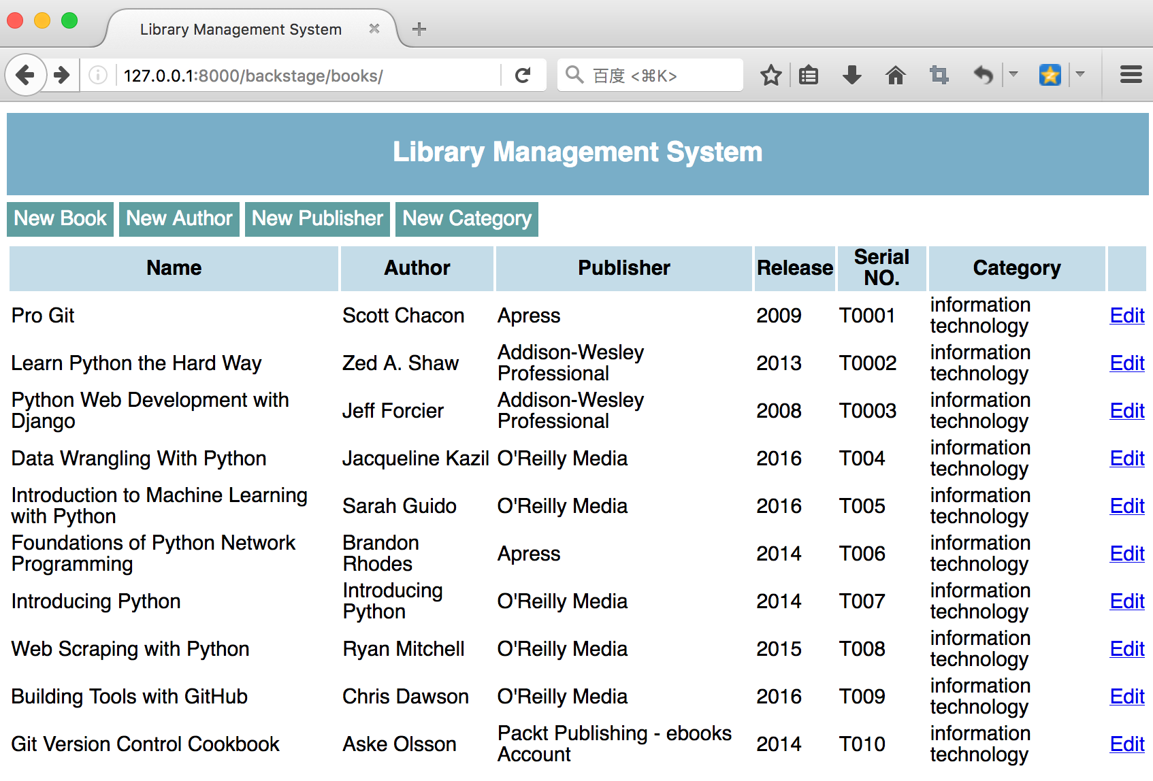
Edit bs_list.html

Slide 28
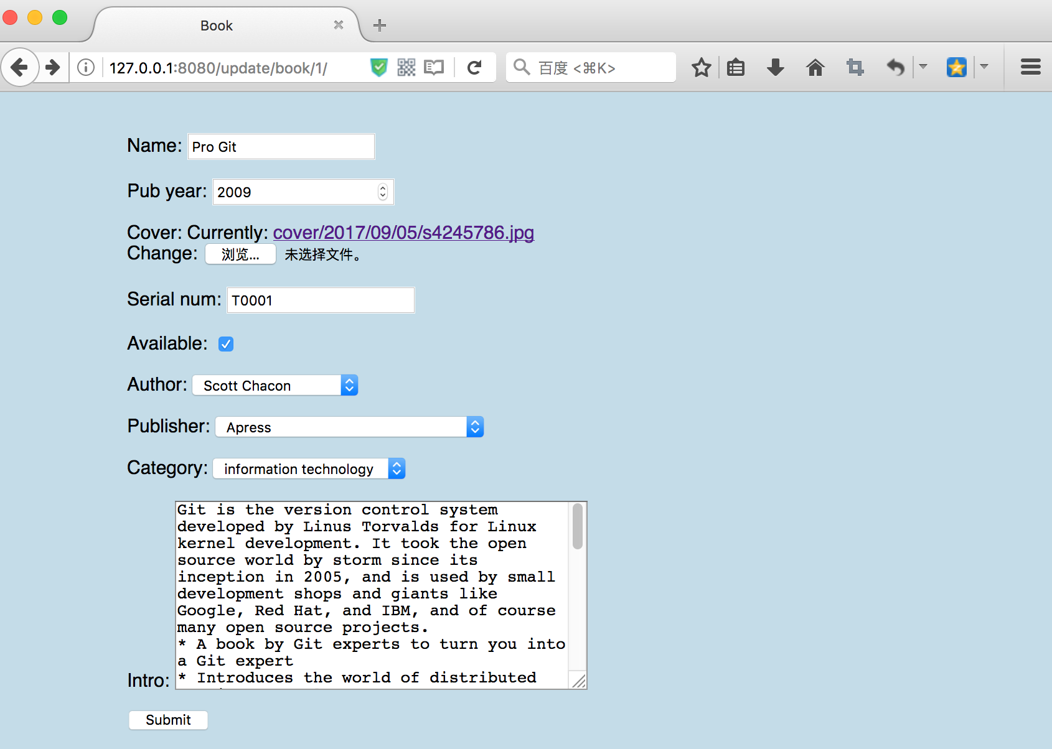

Slide 29
Media file

Slide 30
Media file
The file which user is uploaded will store in media file such as FileField and ImageField.
Before we use it, we should set it up.
Let’s open the settings.py and configure it.

Slide 31
Settings.py
MEDIA_URL = '/media/' MEDIA_ROOT = os.path.join(BASE_DIR, 'media')
This means the uploaded file will automaticlly store to a folder named media.

Slide 32
Settings.py

Slide 33
Settings.py
Now the image store to media folder correctly.
But if we click the link, we still can not open the image.
So we need set the url for media up as well.

Slide 34
url.py
from django.conf import settings from django.conf.urls.static import static from books.views import UpdateBook urlpatterns = [ url(r'^update/book/(?P<pk>\d+)/', UpdateBook.as_view(), name='update_book'), ] + static(settings.MEDIA_URL, document_root=settings.MEDIA_ROOT)

Slide 35
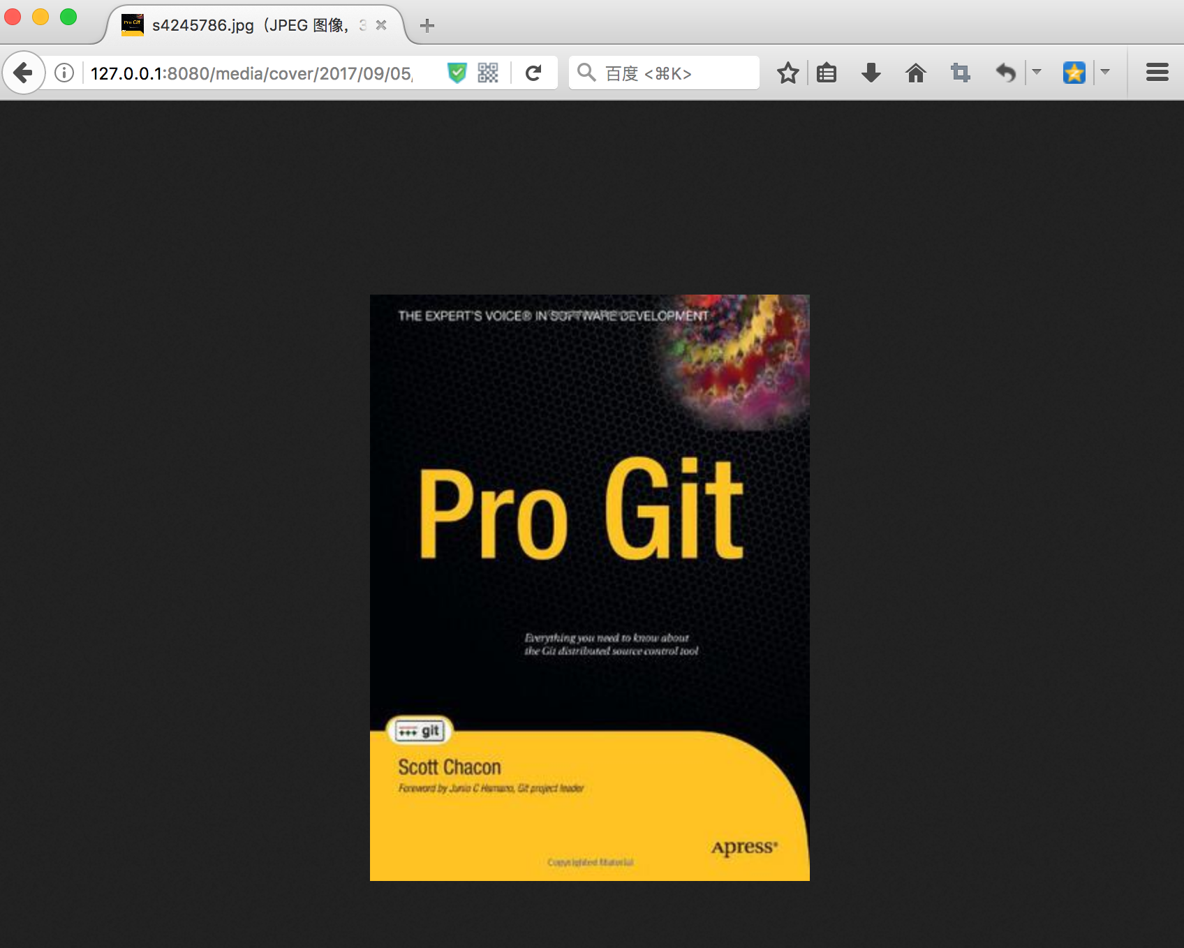
done
Now we can open the link to see the cover of the book.

Slide 36
deleteview

Slide 37
deleteview
A view that displays a confirmation page and deletes an existing object. The given object will only be deleted if the request method is POST. If this view is fetched via GET, it will display a confirmation page that should contain a form that POSTs to the same URL.
class django.views.generic.edit.DeleteView

Slide 38
deleteview
from django.views.generic import DeleteView
from django.urls import reverse_lazy
class DeleteBook(DeleteView): model = Book template_name = 'backstage/delete_book.html' success_url = reverse_lazy('bs_list')

Slide 39
url.py
from books.views import UpdateBook, DeleteBook
urlpatterns = [ url(r'^update/book/(?P<pk>\d+)/', UpdateBook.as_view(), name='update_book'), url(r'^delete/book/(?P<pk>\d+)/', DeleteBook.as_view(), name='delete_book'), ] + static(settings.MEDIA_URL, document_root=settings.MEDIA_ROOT)

Slide 40

Delete_book.html
<body> <form action="" method="post">{% csrf_token %} <p>Are you sure you want to delete "{{ object.name }}"?</p> <input type="submit" value="Confirm" /> </form> </body>

Slide 41
Questions?

